Slide 1
BIGDATA – PPT
BATCH – 5 S180162

Slide 2


Slide 3
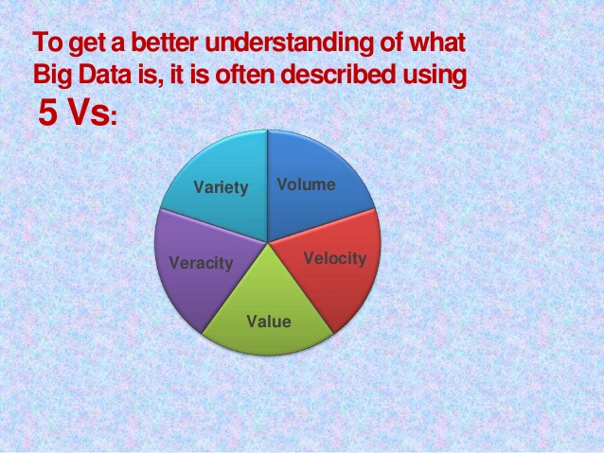
What is Big Data?
Big Data is a collection of large datasets that cannot be processed using traditional computing techniques. It is not a single technique or a tool, rather it involves many areas of business and technology.

Slide 4
Volume
The quantity of generated and stored data. The size of the data determines the value, whether it can actually be considered big data or not.
Variety
The type and nature of the data. This helps people who analyze it to effectively use the resulting insight.
Velocity
The speed at which the data is generated and processed to meet the demands and challenges that lie in the path of growth and development.
Value
Here we are referring to the worthiness of the data being extracted. Having endless amounts of data is one thing, but unless it can be turned into value it is useless.
Veracity
It is the uncertainty of data.
The data quality of captured data can vary greatly, affecting the accurate analysis.

Slide 5
Advantages of BigData
Cost reduction
Time reduction
Efficient.
Some of the components of BigData Processing :
Hadoop
HDFS
MapReduce
Hive
Pig
Sqoop

Slide 6


Slide 7
What is Hadoop?
Hadoop was created by Doug Cutting and Mike Cafarella in 2005.
Hadoop is an open source, Java-based programming framework that supports the processing and storage of extremely large data sets in a distributed computing environment.
Advantages of Hadoop:
Scalable. Hadoop is a highly scalable storage platform, because it can stores and distribute very large data sets across hundreds of inexpensive servers that operate in parallel.
Cost effective.
Flexible,
Fast.
Reliable.

Slide 8
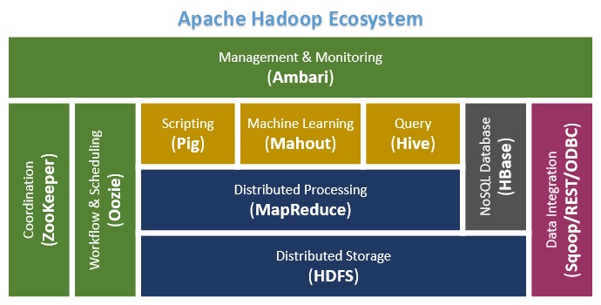

Slide 9
Hadoop Distributed File System (HDFS)
HDFS comprises of 2 important components-
1. NameNode
2. DataNode
HDFS operates on a Master-Slave architecture model where the NameNode acts as the master node for keeping a track of the storage cluster.
The DataNode acts as a slave node summing up to the various systems within a Hadoop cluster.

Slide 10


Slide 11
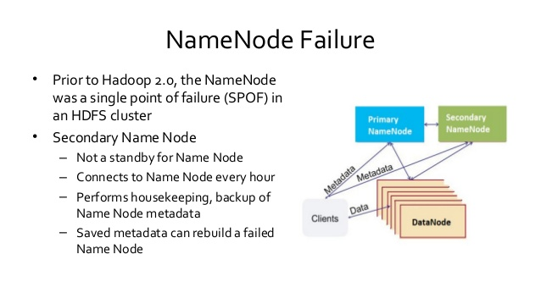

Slide 12
What is a rack in HDFS?
A rack is a collection of 30 or 40 nodes that are physically stored close together and are all connected to the same network switch. A Hadoop Cluster is a collection of racks. Each rack has unique rack id.
Rack Awareness in Hadoop
If the writer is on a datanode, the 1st replica is placed on the local machine, otherwise a random datanode.
The 2nd replica is placed on a datanode that is on a different rack.
The 3rd replica is placed on a datanode which is on a different node of the rack as the second replica.

Slide 13
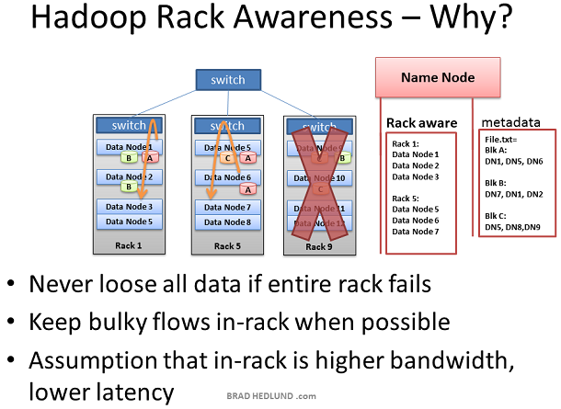

Slide 14
MapReduce
MapReduce is a Java-based system created by Google where the actual data from the HDFS store gets processed efficiently.
In the Hadoop 2 , Hadoop MapReduce is a framework based on YARN architecture. YARN supports parallel processing of huge data sets.
Map Task takes input data and splits into independent chunks and output of this task will be the input for Reduce Task.

Slide 15
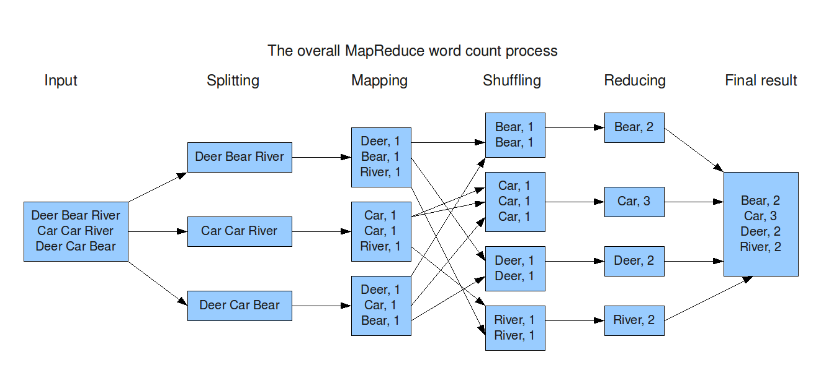

Slide 16
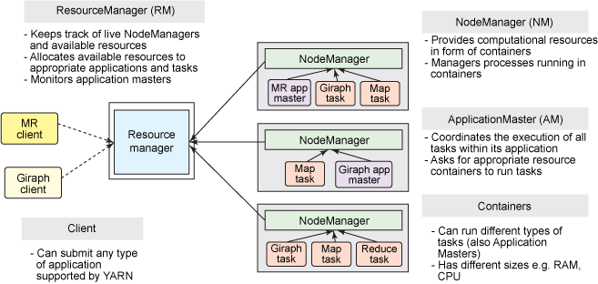

Slide 17
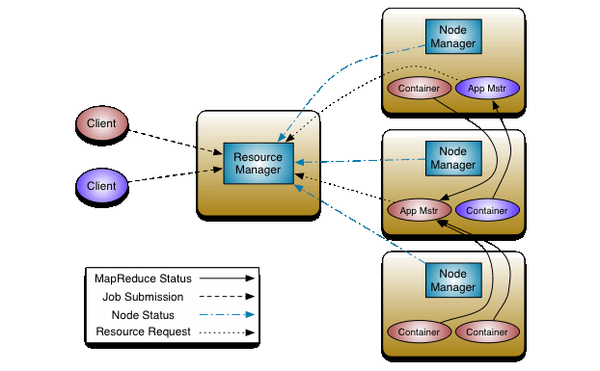
Yarn Architecture

Slide 18
S.No | Hadoop 1 | Hadoop 2
1 | Work with daemons like Task tracker and job tracker. | Works with daemons like Resource manager and Task manager.
2 | There was only single namenode. | Two namenodes are present Active namenode and standby namenode.
3 | There was no concept of YARN, Mapreduce was the one who is doing the cluster resource management. | YARN(Yet another resource negotiator) feature is added in the hadoop2.
4 | Has single point of failure because of only one namenode | Has feature to overcome SPOF with a standby Namenode and in case of Namenode failure.
5 | Has limited number of nodes. Only 4000 nodes were present. | Has better scalability. Scalable up to 10000 nodes per cluster.
6 | Does not support Microsoft windows. | It supports Microsoft windows.

Slide 19


Slide 20
HIVE
Hive is a data warehouse infrastructure tool to process structured data in Hadoop.
It is a platform used to develop SQL type scripts to do MapReduce operations.
It stores schema in a database and processed data into HDFS.

Slide 21


Slide 22
Pig is a procedural language for developing parallel processing applications for large data sets in the Hadoop environment.
Pig is an alternative to Java programming for MapReduce, and automatically generates MapReduce functions.
Pig includes Pig Latin, which is a scripting language. Pig translates Pig Latin scripts into MapReduce, which can then run on YARN and process data in the HDFS cluster.
Pig is commonly used for complex use cases that require multiple data operations.

Slide 23
S.No | HIVE | PIG
1 | Hive is used for structured Data. | PIG is used for semi structured data.
2 | Hive is used as a declarative SQL. | PIG is used as a procedural language.
3 | Hive supports partitions. | PIG does not support partitions, but filters can be used to do their task.
4 | Hive defines tables beforehand (schema) + stores schema information in a database | Pig does not have a dedicated metadata database.
5 | Hive does not support COGROUP feature. | Pig supports COGROUP feature.
6 | Hive does not support Avro. | Pig does not support Avro.

Slide 24
Sqoop:
Sqoop is a tool designed to transfer data between Hadoop and relational database servers. It is used to import data from relational databases such as MySQL, Oracle to Hadoop HDFS, and export from Hadoop file system to relational databases.

Slide 25
About Project
The H1B is an employment-based, non-immigrant visa category for temporary foreign workers in the United States. For a foreign national to apply for H1B visa, an US employer must offer a job and petition for H1B visa with the US immigration department. This is the most common visa status applied for and held by international students once they complete college/ higher education (Masters, Ph.D.) and work in a full-time position.
Example of the H1b raw dataset :
1","CERTIFIED-WITHDRAWN","UNIVERSITY OF MICHIGAN","BIOCHEMISTS AND BIOPHYSICISTS","POSTDOCTORAL RESEARCH FELLOW","N",36067,2016,"ANN ARBOR, MICHIGAN",-83.7430378,42.2808256

Slide 26
Cleansing Data :
Step 1 - A table h1b_applications is created with the following columns s_no, case_status, employer_name, soc_name, job_title, full_time_position, prevalling_wage, year, worksite, longitute, latitude. SERDE functions are used to separate the values with “”.
Step 2 - The data is loaded into the table from local file system.
Step 3 - Table h1b_app2 is created with field delimiter “\t”. Data is loaded
From h1b_applications table where field separators “,” is replaced by “\t”.
Step 4 - A condition is declared to ignore records with NA in the case status.

Slide 27
Step 5 - A new table h1b_final is created and datas from the h1b_app2 table are loaded but the case status column is filtered only for CERTIFIED, CERTIFIED-WITHDRAWN,DENIED AND WITHDRAWN. This table provides us the final cleansed dataset for which all the analysis has to be done.
Example of dataset after cleansing:
1 CERTIFIED-WITHDRAWN UNIVERSITY OF MICHIGAN BIOCHEMISTS AND BIOPHYSICISTS POSTDOCTORAL RESEARCH FELLOW N 36067 2016 ANN ARBOR, MICHIGAN -83.7430378 42.2808256
Tools used in the project:
MapReduce
Hive
Pig

Slide 28
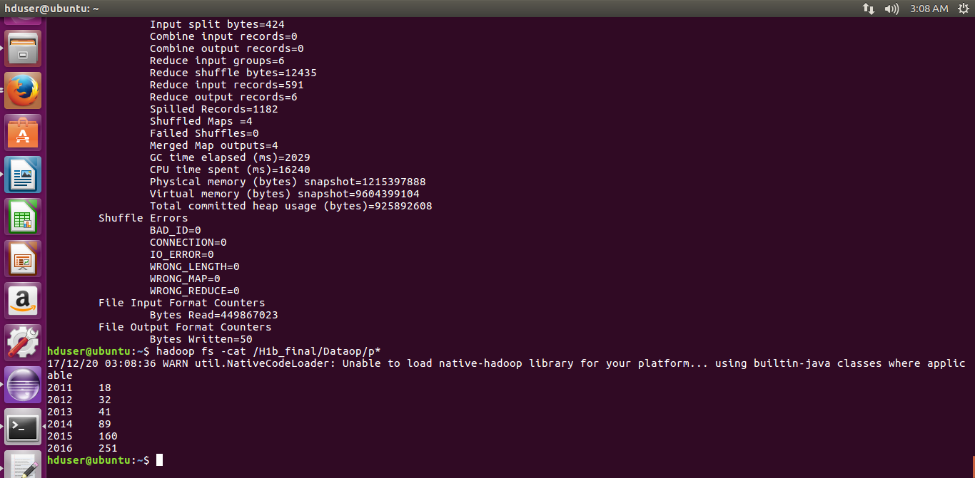
Sample output for MapReduce :

Slide 29
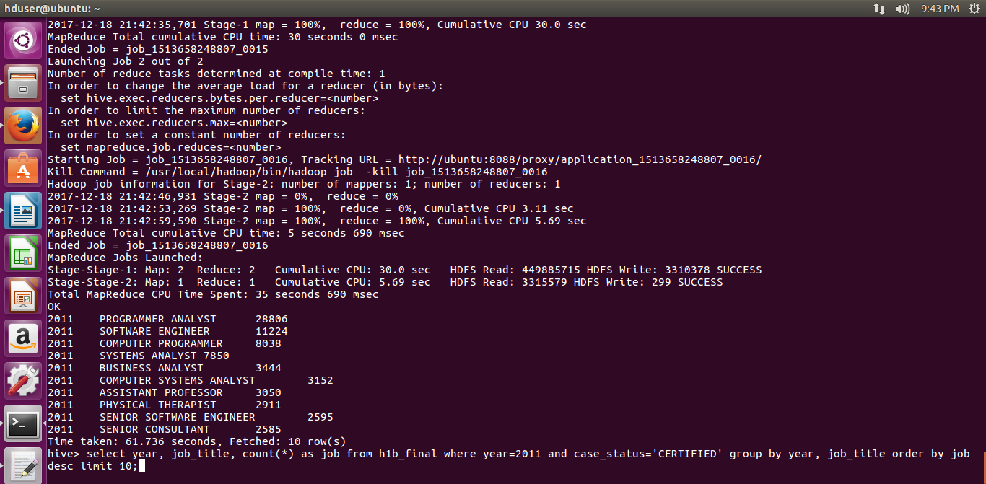
Sample output for Hive :

Slide 30
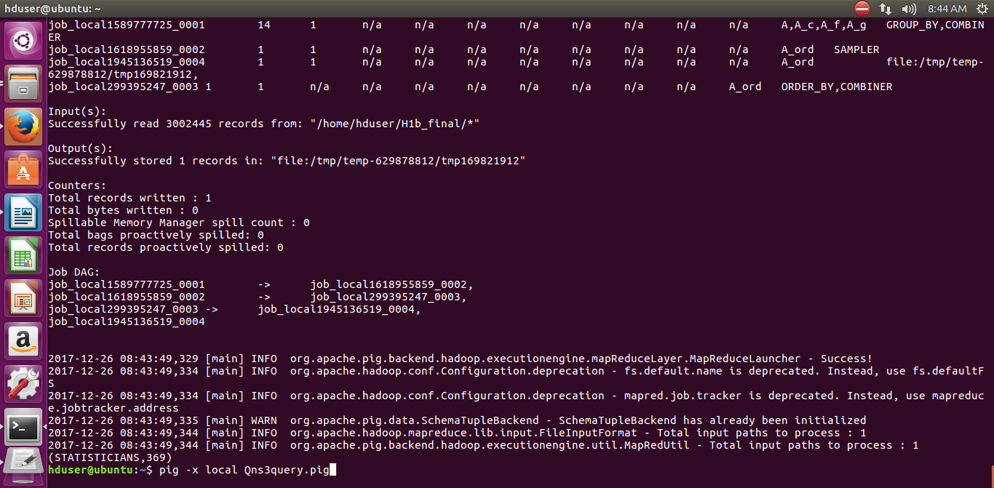
Sample output for Pig :

Slide 31
THANK YOU

